Slide 1

Introduction to single-cell RNA-seq technologies
Caltech Bi/BE/CS183, Spring 2019
Instructors: Lior Pachter and Matt Thomson
TAs: Eduardo Beltrame, Jialong Jiang, Dongyi Lu Based on discussions and calculations with Eduardo Beltrame, Jase Gehring and Valentine Svensson
For notes related to the slides see https://liorpachter.wordpress.com/2019/02/19/introduction-to-single-cell-rna-seq-technologies/

Slide 2
The ideal single-cell transcriptomics method
Universal in terms of cell size, type and state.
In situ measurements.
No minimum input of number of cells to be assayed.
Every cell is assayed, i.e.100% capture rate.
Every transcript in every cell is detected, i.e.100% sensitivity.
Every transcript is identified by its full-length sequence.
Transcripts are assigned correctly to cells, e.g. no doublets.
Additional multimodal measurements.
Cost effective per cell.
Easy to use.
Open source.

Slide 3
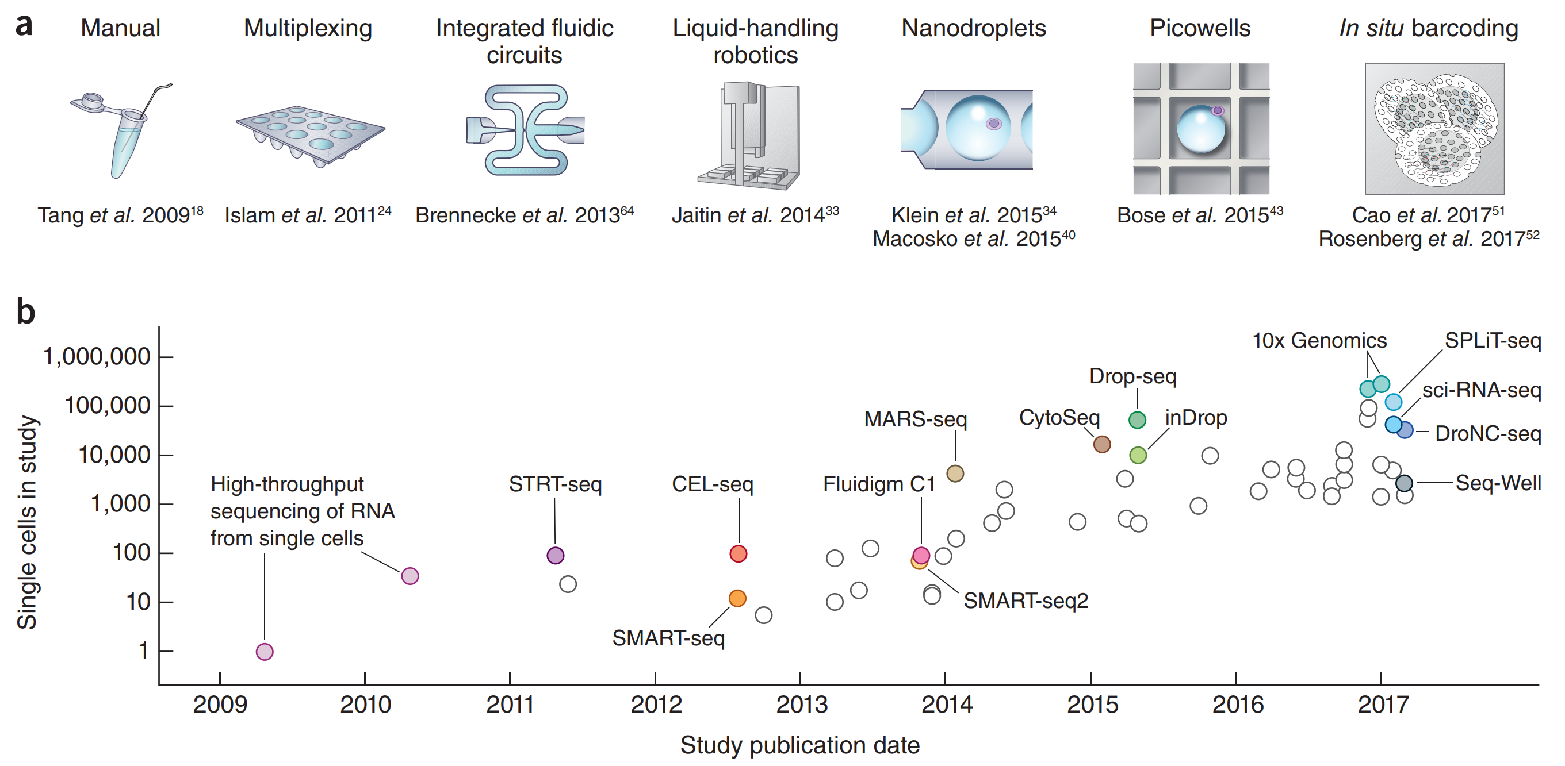
A decade of single-cell RNA-seq

Slide 4
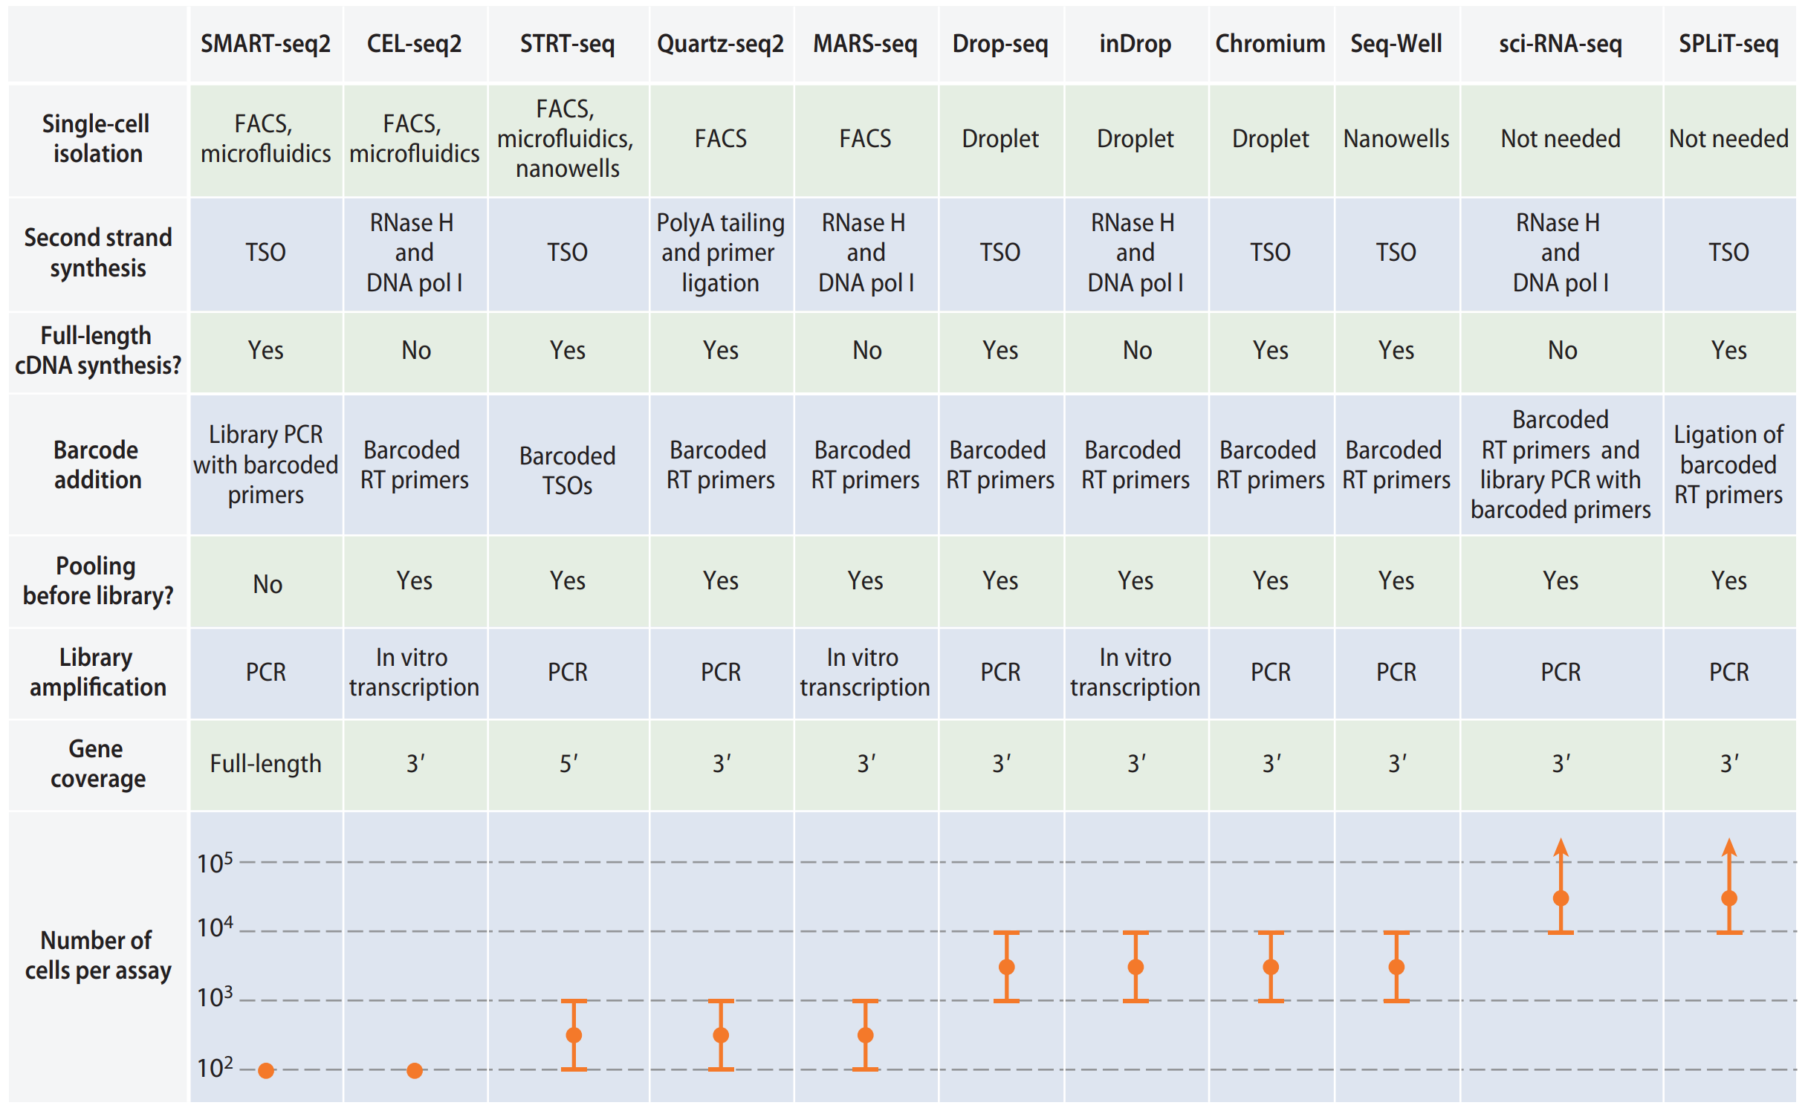
Popular single-cell RNA-seq protocols

Slide 5
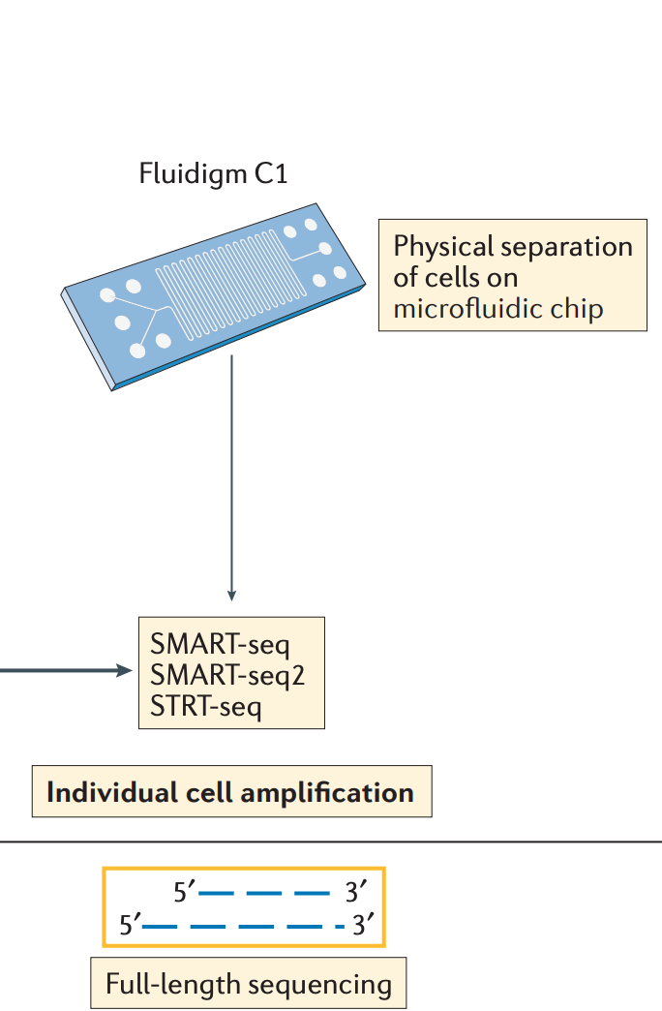
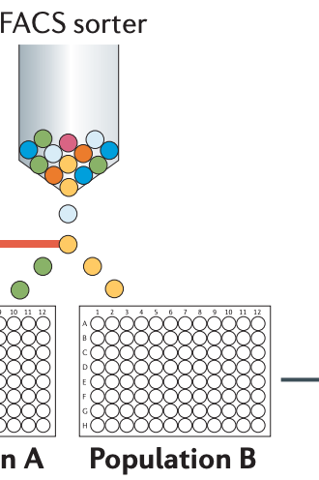
Physical separation of cells in wells

Slide 6
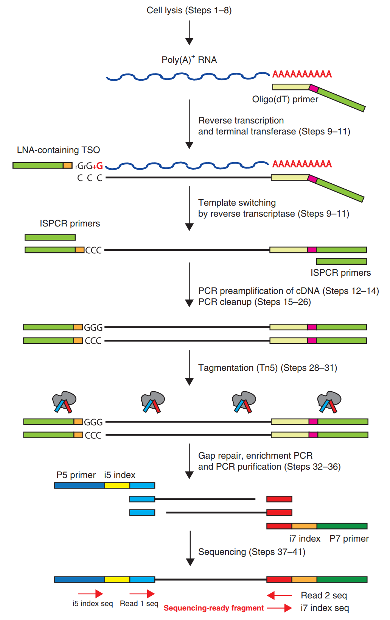
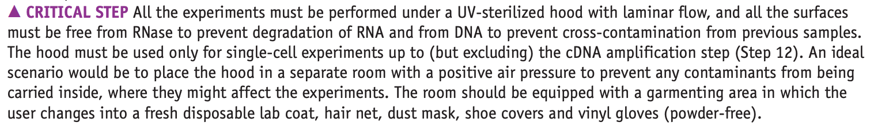
Example: library preparation for SMART-Seq2

Slide 7
Example: SMART-Seq2 performance
Universal in terms of cell size, type and state.
In situ measurements.
No minimum input of number of cells to be assayed.
Every cell is assayed, i.e.100% capture rate.
Every transcript in every cell is detected, i.e.100% sensitivity.
Every transcript is identified by its full-length sequence.
Transcripts are assigned correctly to cells, e.g. no doublets.
Additional multimodal measurements.
Cost effective per cell.
Easy to use.
Open source.
*Positive
*Ok
*Negative

Slide 8
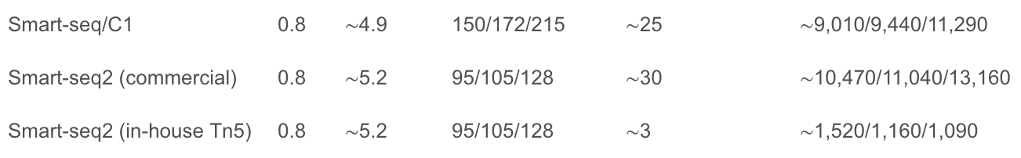
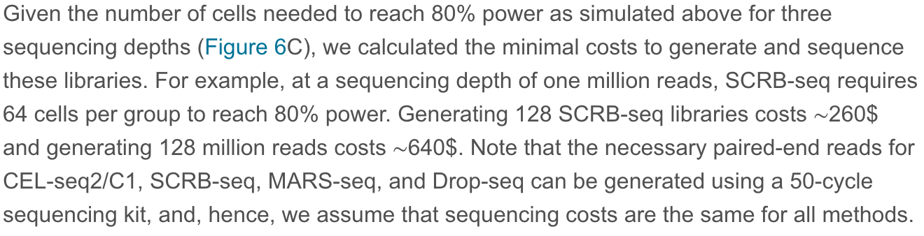
Cost is complicated to measure

Slide 9
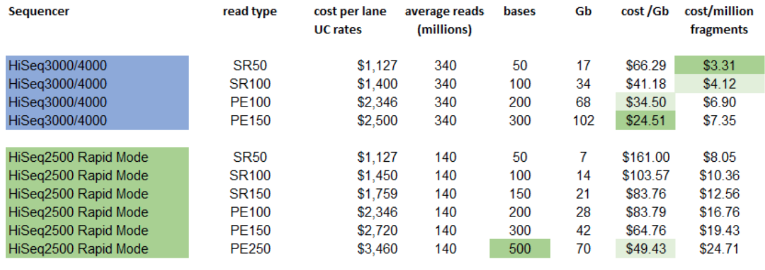
Sequencing costs are also complicated

Slide 10
Microfluidic methods
Drop-seq
Macosko et al., Highly parallel genome-wide expression profiling of individual cells using nanoliter droplets, 2015.DOI:10.1016/j.cell.2015.05.002
Klein et al., Droplet barcoding for single-cell transcriptomics applied to embryonic stem cells, 2015.DOI:10.1016/j.cell.2015.04.044
Song, Chen, Ismagilov, Reactions in droplets in microfluidic channels, 2006. DOI:10.1002/anie.200601554
Guo, Rotem, Heyman and Weitz, Droplet microfluidics for high-throughput biological assays, 2012. DOI:10.1039/C2LC21147E
inDrops

Slide 11
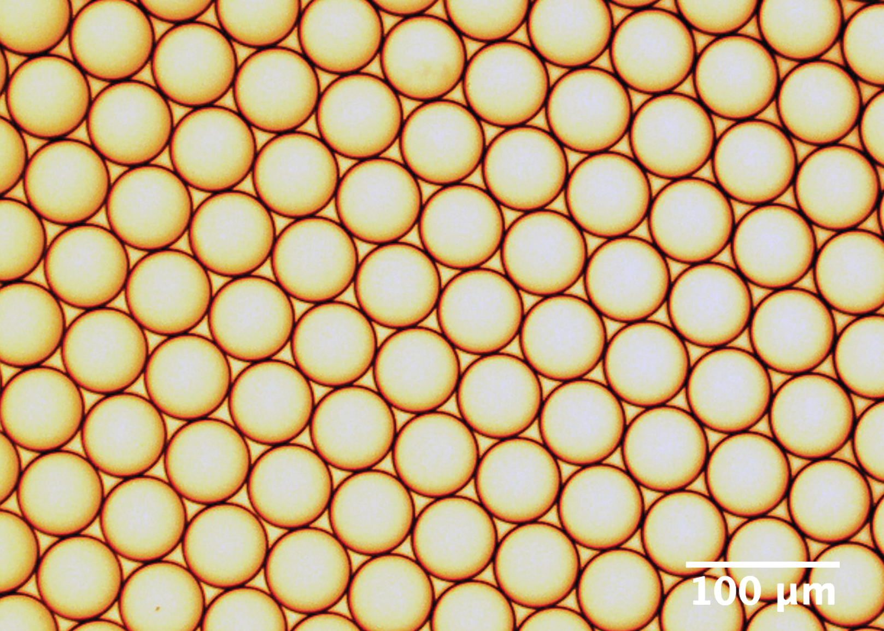
Foundation: homo-dispersed emulsions

Slide 12
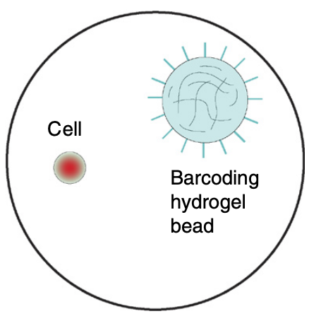
Beads, Cells and Droplets

Slide 13
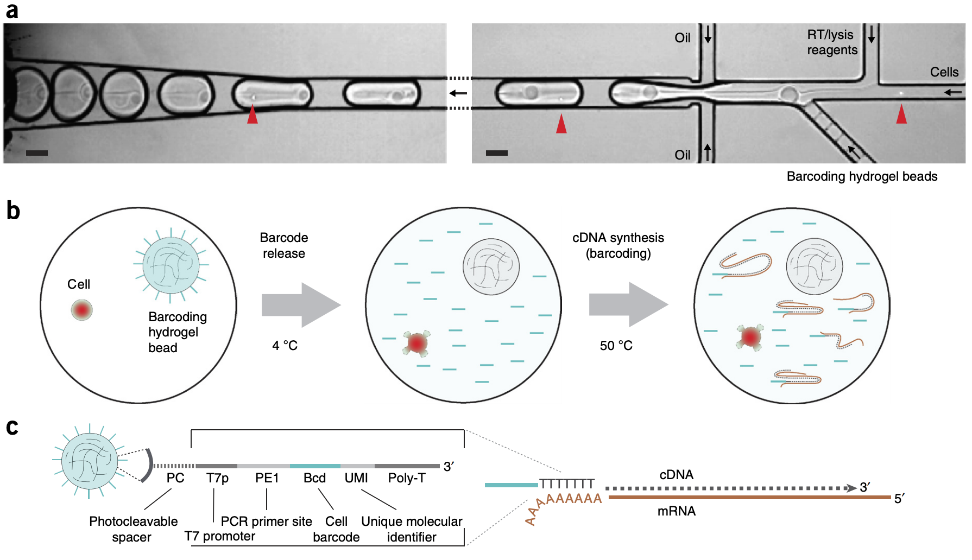
Example: the inDrops approach

Slide 14
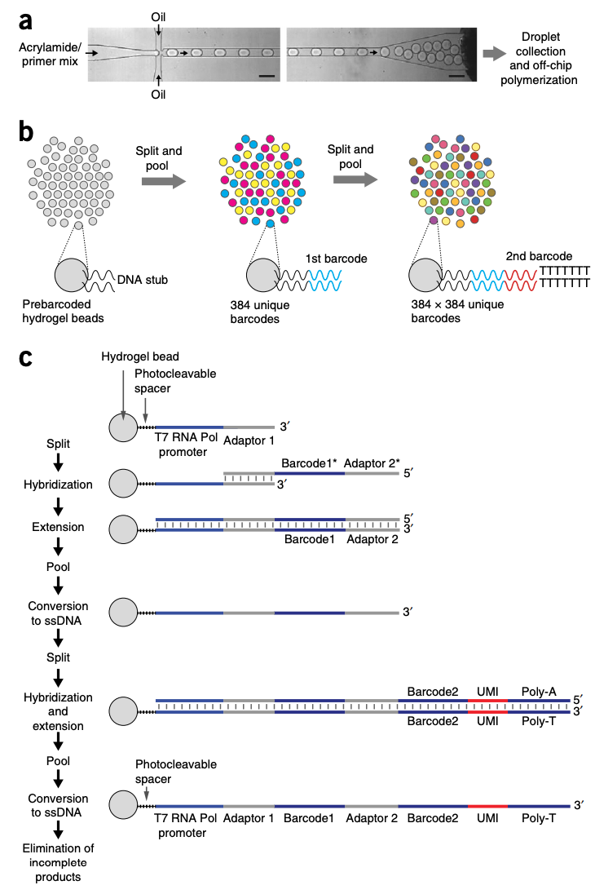
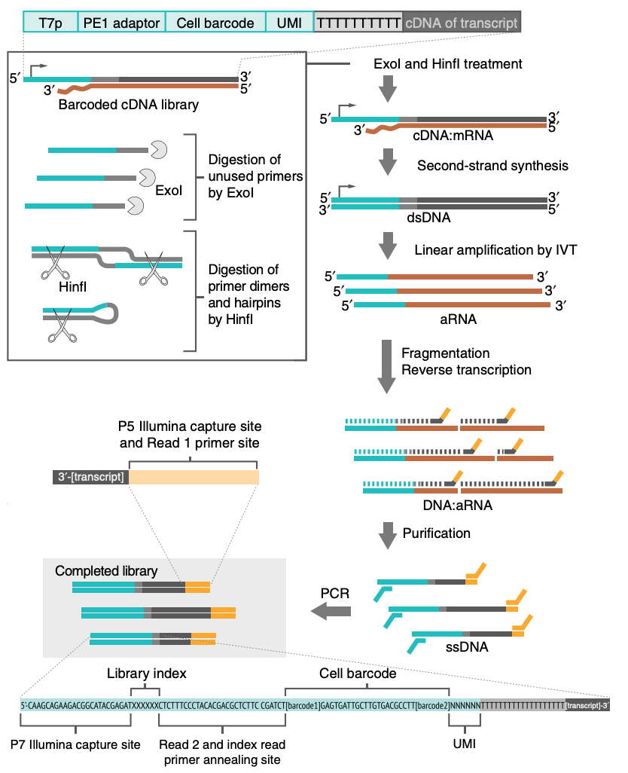
Example: the inDrops protocol
Making hydrogel beads
Library preparation

Slide 15
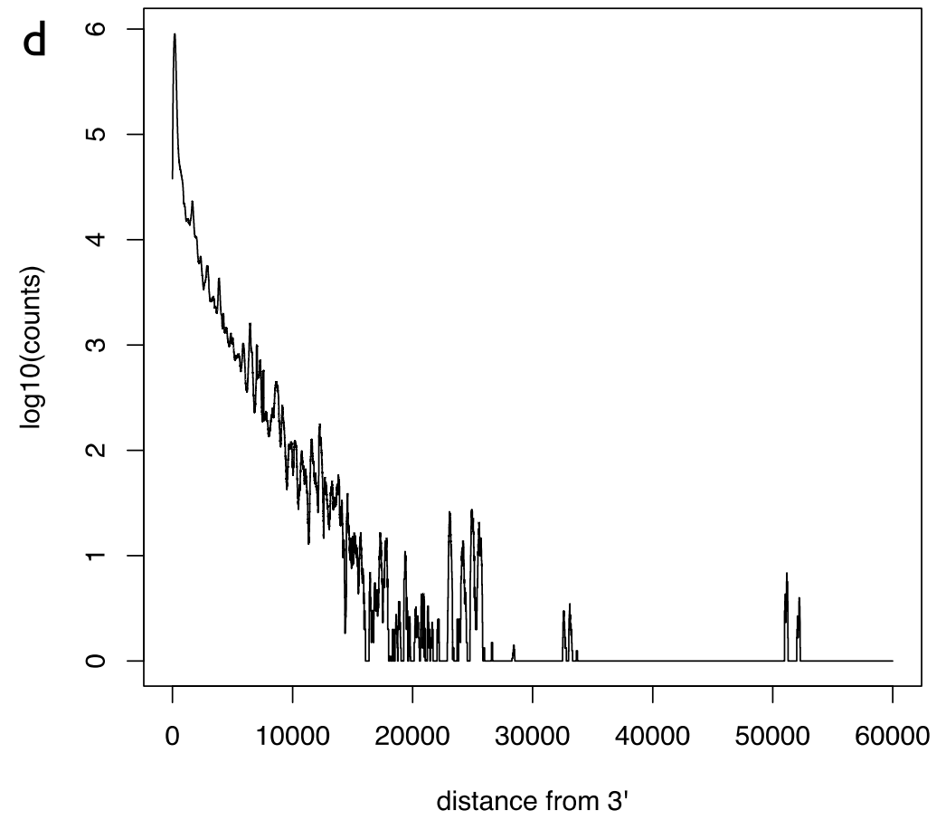
What it means to be “3’ technology”

Slide 16
Droplet tuning concepts
Load beads into droplets at Poisson rate .
Load cells into droplets at Poisson rate .

Slide 17
Cell capture and duplication rates
The cell capture rate is the probability that a droplet has at least one bead = .
The cell duplication rate is the rate at which captured single cells are associated with two or more different barcodes, which is equal to .
This leads to a tradeoff:

Slide 18
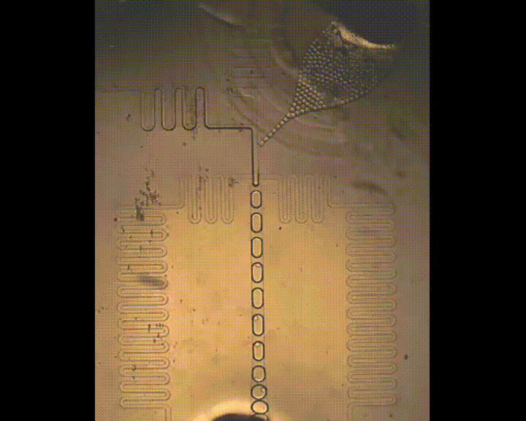
“Sub-Poisson” loading with hydrogel beads

Slide 19
Bead details
 | Drop-seq | inDrops | 10x genomics
Bead Material | Polystyrene | Hydrogel | Hydrogel
Loading Dynamics | Poisson | Sub-Poisson | Sub-Poisson
Dissolvable | No | No | Yes
Barcode Release | No | UV release | Chemical release
Customizable | Demonstrated | Not shown | Feasible
Licensing | Open Source | Open source | Proprietary
Availability | Beads are sold | Commercial | Commercial

Slide 20
Barcode collisions
Barcode collisions arise when two cells are separately encapsulated with beads that contain identical barcodes.
For N assayed cells and M barcodes, the barcode collision rate is the expected proportion of assayed cells that did not receive a unique barcode:
Barcode collisions lead to synthetic doublets. Avoiding synthetic doublets requires high relative barcode diversity, i.e., a small ratio of N/M.
.

Slide 21
Barcode diversity and barcode length
A 1% synthetic doublet rate requires a barcode diversity rate of ~1%, i.e. the number of barcodes should be 100 times the number of cells. The number of barcodes from a sequence of length L is 4^{L}. Therefore, to assay N cells, the barcode sequence must be of length at least:
This is a minimum and does not account for the need to be robust to sequencing errors.

Slide 22
Technical doublets
Technical doublets arise when two or more cells are captured in a droplet with a single bead. The technical doublet rate is therefore the probability of capturing two or more cells in a droplet given that at least one cell has been captured in a droplet:
Note that “overloading” a microfluidics single-cell experiment by loading more cells while keeping flow rates constant will increase the number of technical doublets due to an effective increase in and also the number of synthetic doublets due to a decrease in relative barcode diversity.

Slide 23
Doublet detection: the barnyard plot

Slide 24
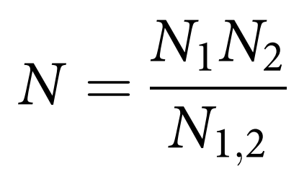
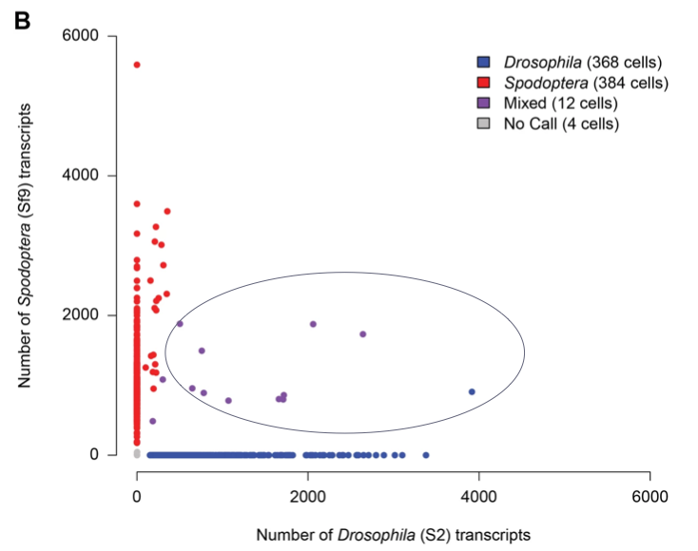
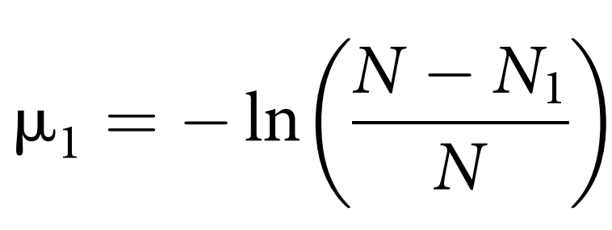
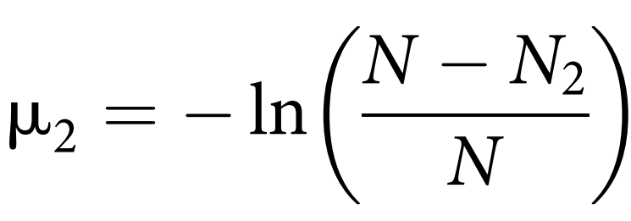
Bloom’s correction
In the notation of Bloom et al. 2018, let N = number of droplets, N1, N2 = number of cells of type 1, 2. N1,2 = number of observed doublets and μ₁, μ₂ = average number of cells of type 1,2. If M = probability that a droplet with at least one cell contains multiple cells then one can estimate M by first computing N as and then , .
One then obtains
This calculation is an estimate only of the technical doublet rate.

Slide 25
Biological doublets
Biological doublets arise when two cells form a discrete unit that does not break apart during disruption to form a suspension.
Biological doublets will not be detected via barnyard plots.
One approach to avoiding biological doublets is to perform nuclear single-cell RNA-seq: Habib et al. 2017. DOI:10.1038/nmeth.4407
However, biological doublets are not necessarily just a technical nuisance to be avoided. The recent paper Halpern et al. 2018, DOI:10.1038/nbt.4231 utilizes biological doublets of hepatocytes and liver endothelial cells to assign tissue coordinates to liver endothelial cells via imputation from their hepatocyte partners.

Slide 26
Unique Molecular Identifiers (UMIs)
Length must determined similarly to the way lengths of barcodes must be determined by the barcode collision rate.
“UMI collapsing” refers to the process of using UMIs to avoid double-counting molecules after sequencing.
naïve UMI collapsing consists of just counting reads that have the same UMI, cell barcode, and whose cDNAs align to the same location, as a single event.
More sophisticated UMI collapsing involves allowing for cases where cDNAs may align to different locations within the same gene. UMI collapsing “with respect to genes” accomodates for PCR artifacts and incomplete gene annotations: Sena et al. 2018. DOI:10.1038/s41598-018-31064-7

Slide 27
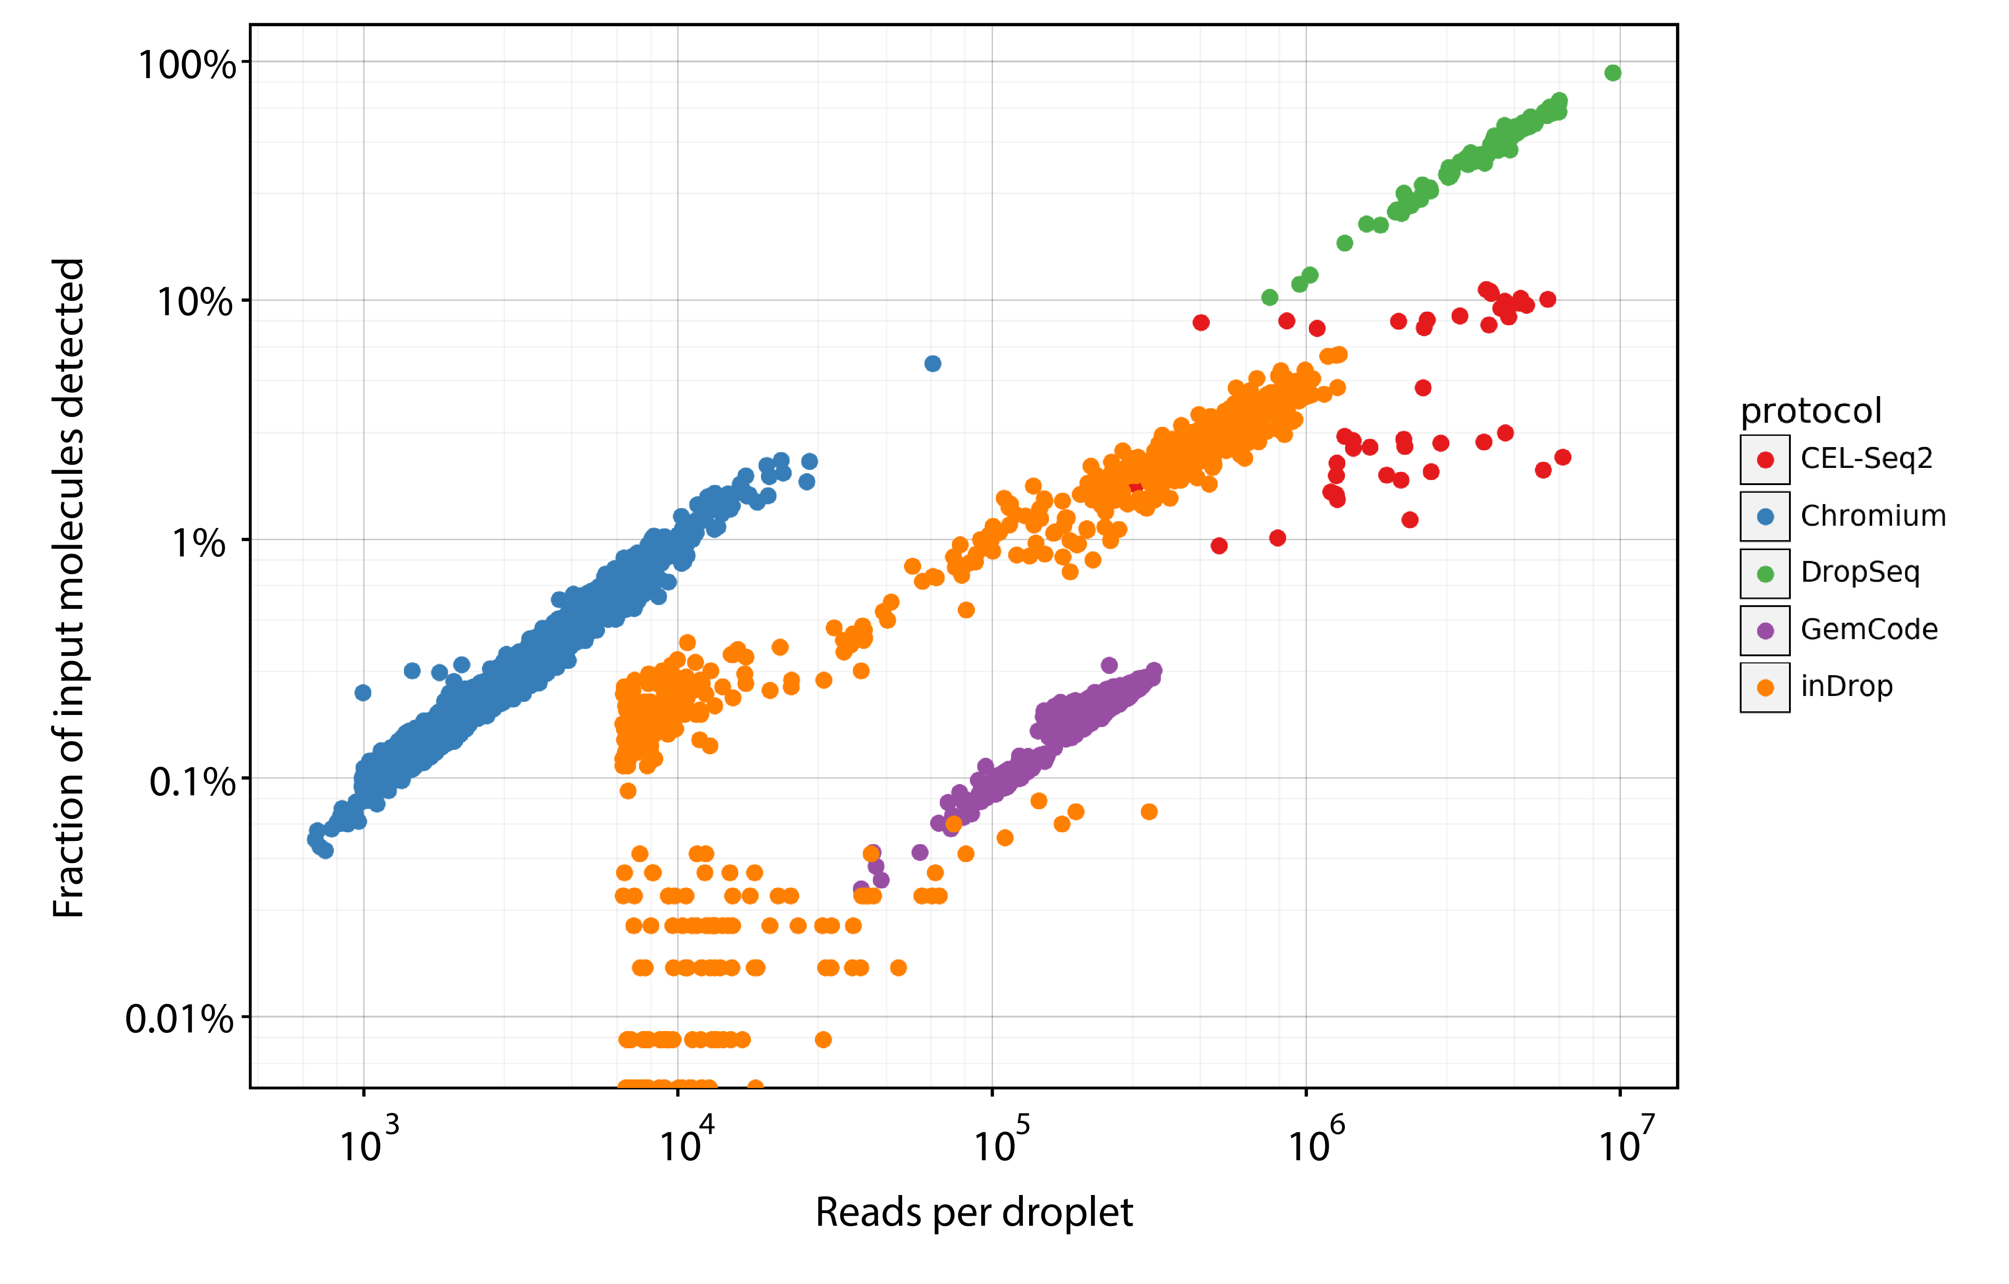
Sensitivity is measured by two parameters
Analysis of data from from Svensson et al. 2017. DOI:10.1038/nmeth.4220

Slide 28
Example: inDrops performance
Universal in terms of cell size, type and state.
In situ measurements.
No minimum input of number of cells to be assayed.
Every cell is assayed, i.e.100% capture rate.
Every transcript in every cell is detected, i.e.100% sensitivity.
Every transcript is identified by its full-length sequence.
Transcripts are assigned correctly to cells, e.g. no doublets.
Additional multimodal measurements.
Cost effective per cell.
Easy to use.
Open source.
*Positive
*Ok
*Negative

Slide 29
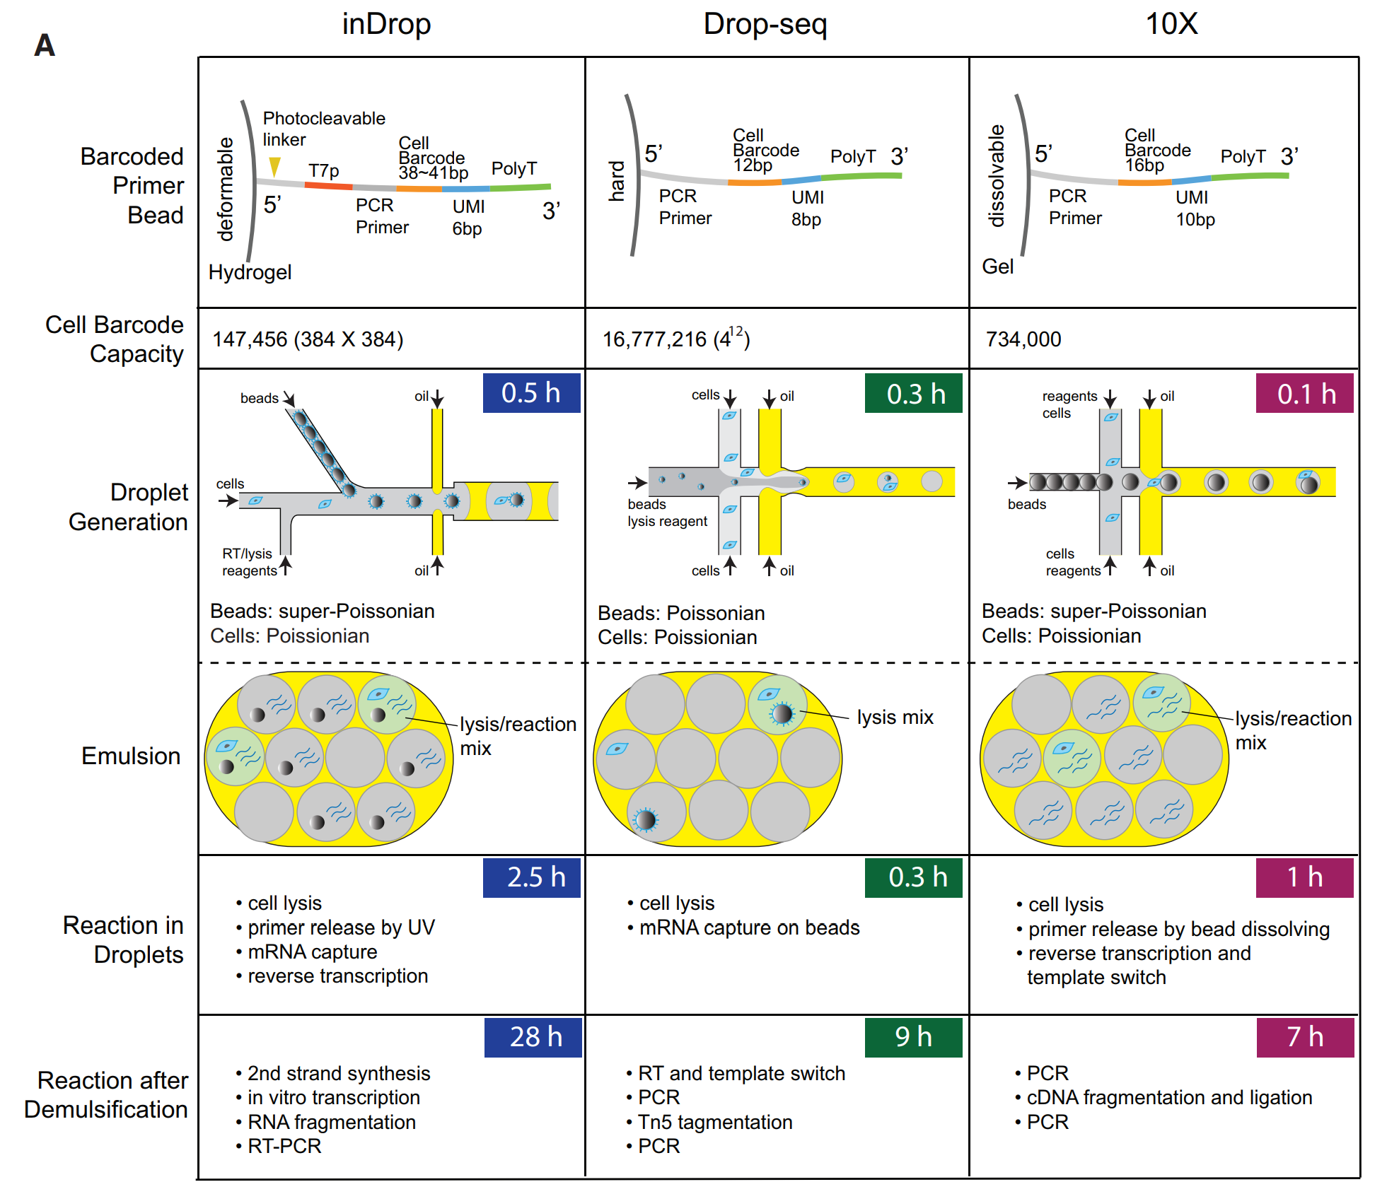
Summary of droplet technologies

Slide 30
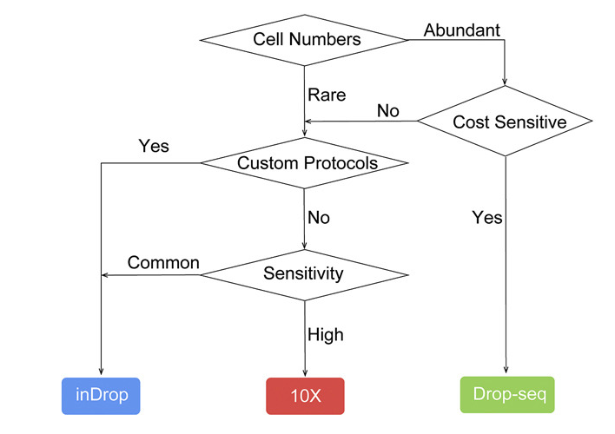
Technical details matter when choosing a system

Slide 31
Examples of related technology developments
Multimodal assays.
Patch-seq: Cadwell et al. 2015. DOI:10.1038/nbt.3445
sci-CAR: Cao et al. 2018. DOI:10.1126/science.aau0730
Multiplexing of samples.
Cell hashing: Stoeckius et al. 2018. DOI:10.1186/s13059-018-1603-1
Click tags: Gehring et al. 2018. DOI:10.1101/315333
Spatial single-cell technologies.
seqFISH: Lubeck et al. 2014. DOI:10.1038/nmeth.2892
MERFISH: Chen et al. 2015. DOI:10.1126/science.aaa6090
Packer and Trapnell 2018. DOI:10.1016/j.tig.2018.06.001

